Slide 1
Harnessing LLMs from the Terminal with Simon Willison’s `llm`
Phebe Polk

Slide 2
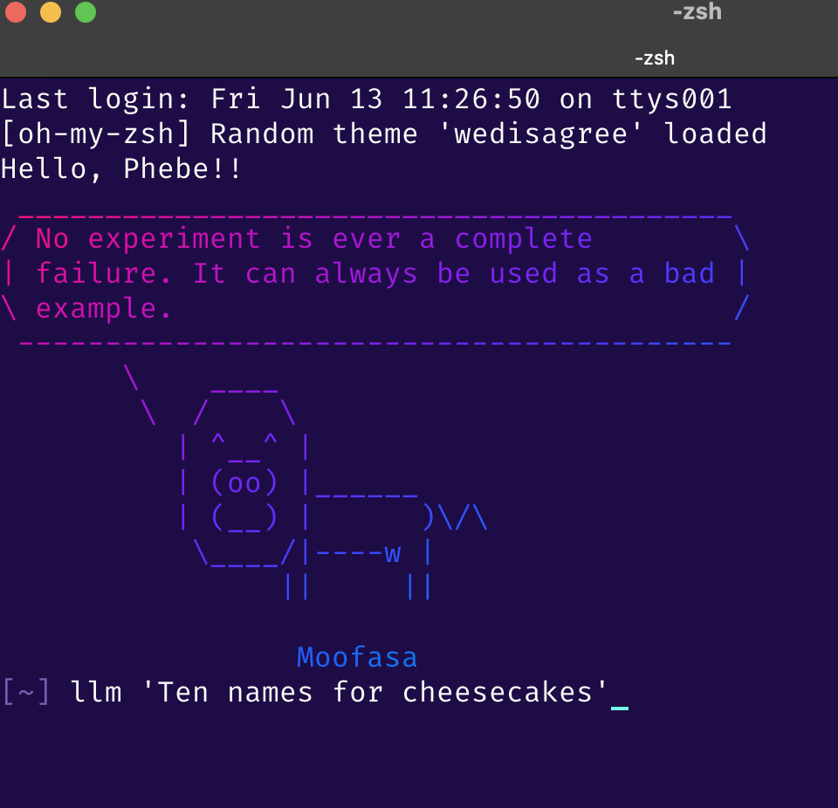
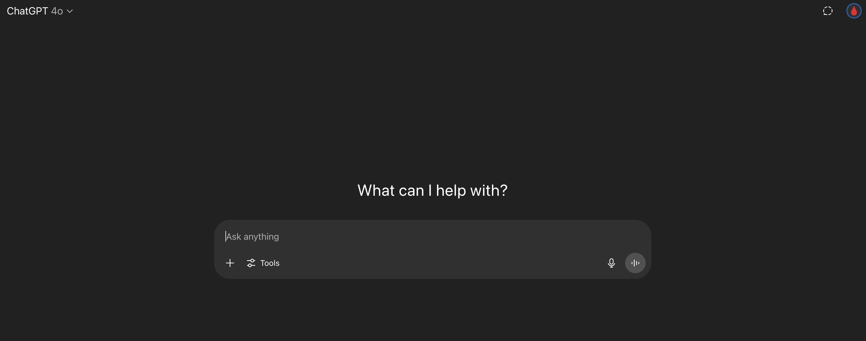
What?
From This GUI’s:
To This →

Slide 3
Why?
Reproducible
Comparisons
Interactive
Local

Slide 4
Features
🔧 CLI-based access to LLMs: `llm "What is the capital of France?"`
📦 Built-in SQLite logging for queries + results.
🔌 Plugin system: easy to add support for new models or customize behavior.
🛠️ Embeddable API: Can be used in Python/JavaScript projects.

Slide 5
LOGS LOGS LOGS!
All prompts/responses stored locally
SQLite-backed log
Great for audit/debug

Slide 6
Demo

Slide 7
Real World Uses
Automatically generate SQL queries from natural language.
Chain prompts together with custom workflows.
Create scripts that call LLMs and log results.
Experiment with prompt engineering in a reproducible way.

Slide 8
Try It!
🌐 https://llm.datasette.io
📦 GitHub: simonw/llm

Slide 9
Questions? Comments?
Thanks!

